Slide 1


Chicago Crime rate
How Socioeconomic factors influence the crime rate

Slide 2


Analysts
Christopher Habib
Siddharth Krishnan
Ali Kashani
Elmaddin Karimov

Slide 3

Data Curated datasets:
https://dev.socrata.com/foundry/data.cityofchicago.org/6zsd-86xi
https://data.cityofchicago.org/Health-Human-Services/Census-Data-Selected-socioeconomic-indicators-in-C/kn9c-c2s2

Slide 4
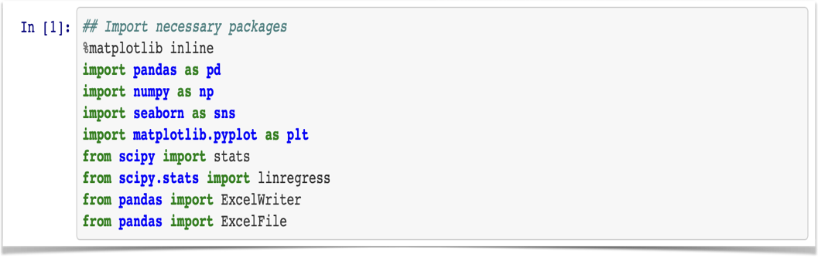
Import Packages
The above Packages for executing our analysis

Slide 5
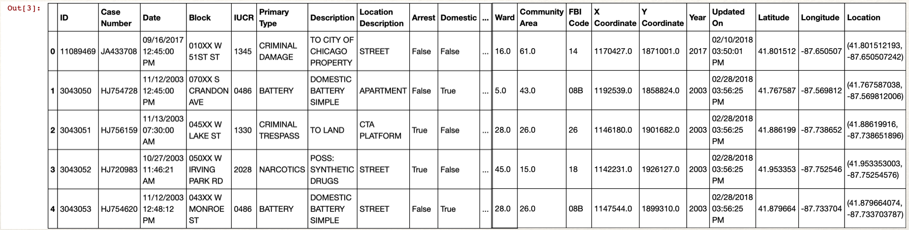
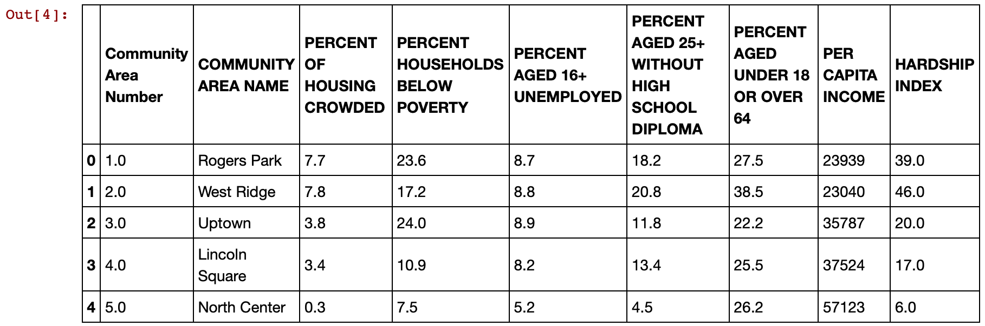
df = pd.read_csv(‘resources/Crimes_-_2001_to_present.csv')
census = pd.read_csv('resources/Census_Data_-_Selected_socioeconomic_indicators_in_Chicago__2008___2012.csv')

Slide 6
Approach
Find crime types and obtain data from the right source
Analyse and clean data
Find which crime was the most highest committed
By using the socioeconomic indicators we analysed 4 years of data
Select crime data for 5 years 2008-2012
Merge the new data to get meaningful insights
Analyse impact of indicators on theft levels
Analyse correlation between theft and crime levels

Slide 7
Data Cleaning
Extract Crime data for years 2008-2012
Changed combined thefts, robberies and auto-thefts into a single THEFT category
Merged both datasets on Community Area column
Checked for null-values

Slide 8

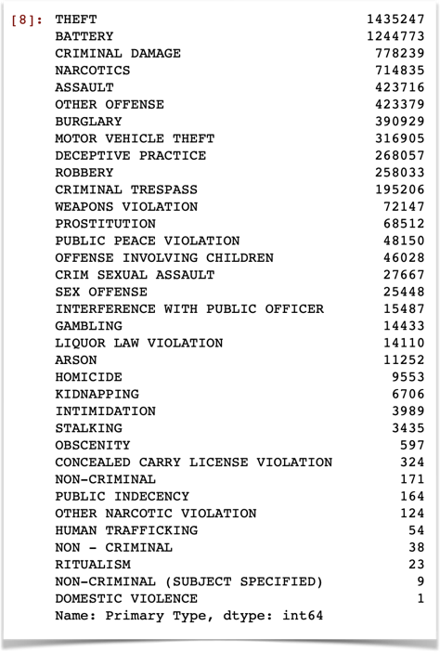
By using this syntax
We determined the most committed Crime
df['Primary Type'].value_counts()

Slide 9
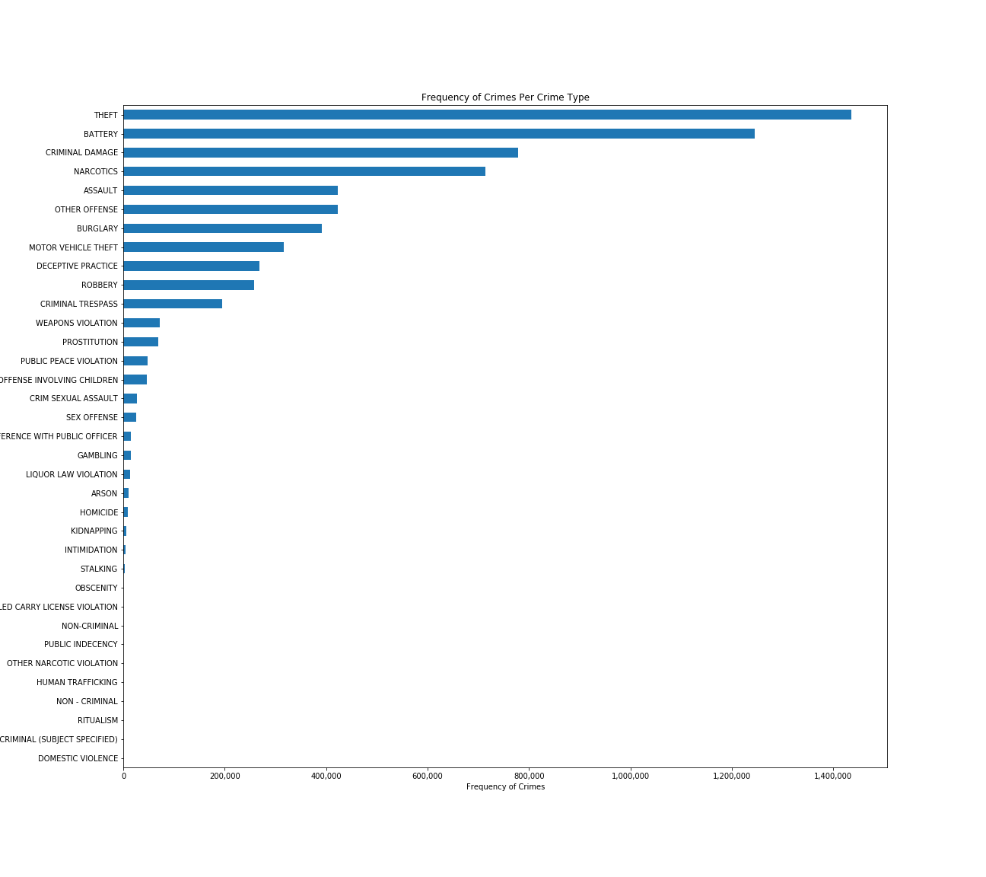

Slide 10
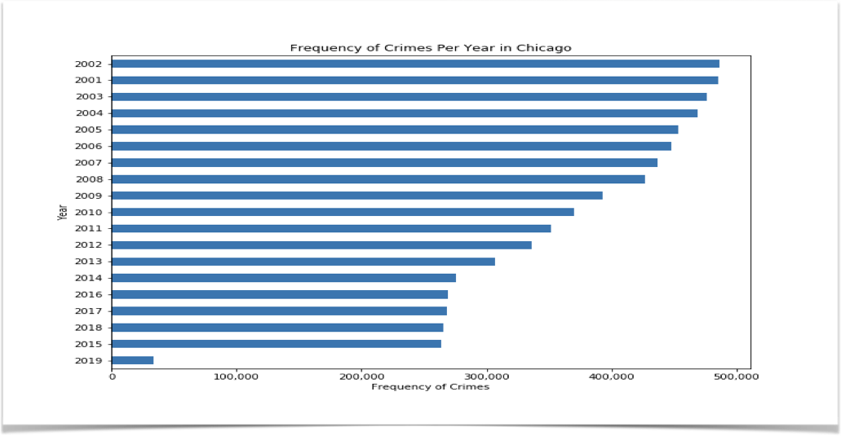
Determined Frequency of Crimes per year

Slide 11
Merging the Data to analyse and determine a relationship
Between Hardship Index and Theft
crime08 = df.loc[df["Year"]==2008]
crime09 = df.loc[df[“Year"]==2009]
crime10 = df.loc[df["Year"]==2010]
crime11 = df.loc[df["Year"]==2011]
crime11 = df.loc[df["Year"]==2011]
crime12 = df.loc[df["Year"]==2012]
crime_data=pd.merge(crime08,census,on="Community Area")
crime_data1=pd.merge(crime09,census,on="Community Area")
crime_data2=pd.merge(crime10,census,on="Community Area")
crime_data3=pd.merge(crime11,census,on="Community Area")
crime_data4=pd.merge(crime12,census,on="Community Area")
crime2=pd.concat([crime_data, crime_data1,crime_data2,crime_data3,crime_data4])
crime2.columns
theft=crime2.loc[crime2["Primary Type"]=="THEFT"]
theft

Slide 12
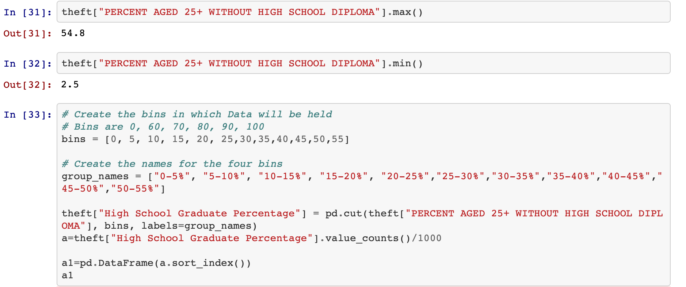
Relationship between Theft and High School Diploma

Slide 13
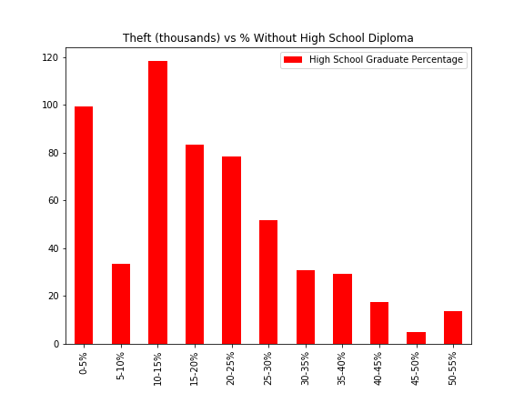
Theft vs % Without High School Graduate Percentage
% without High School | Theft
0-5% | 99.358
5-10% | 33.626
10-15% | 118.199
15-20% | 83.236
20-25% | 78.196
25-30% | 51.724
30-35% | 30.704
35-40% | 29.352
40-45% | 17.390
45-50% | 5.033
50-55% | 13.641

Slide 14
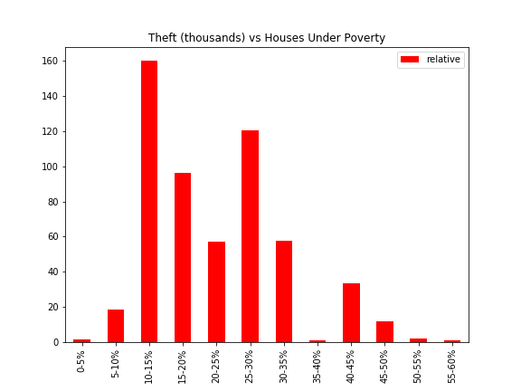
Theft vs % Houses Under Poverty

Slide 15
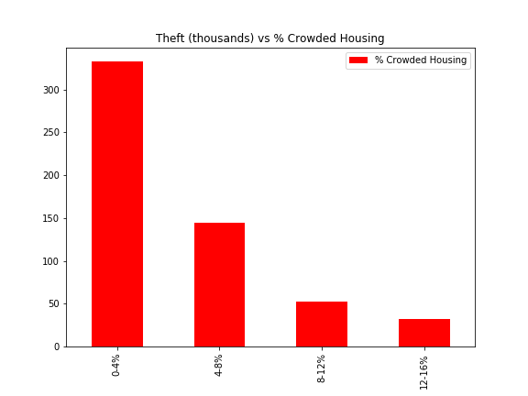
Theft vs % Crowded Housing

Slide 16
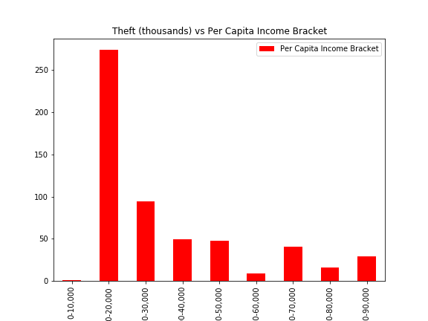
Theft vs Per Capita Income Bracket

Slide 17
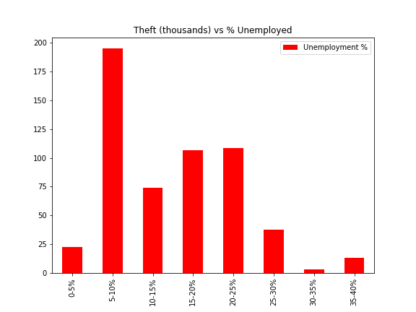
Theft vs % Unemployed

Slide 18
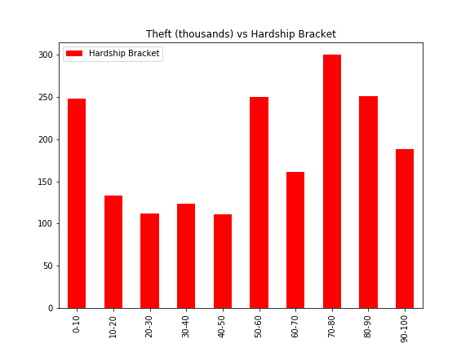
Theft vs Hardship Bracket

Slide 19
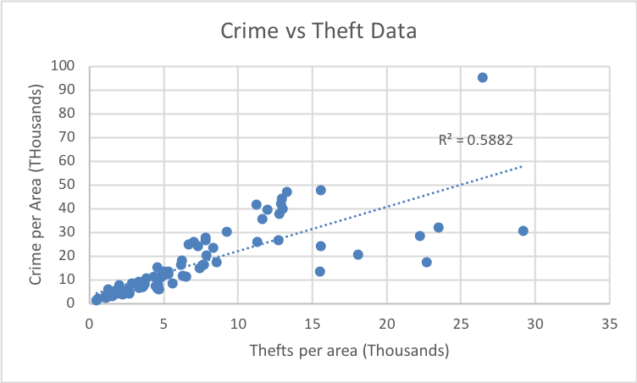
Crime vs Theft Data

Slide 20
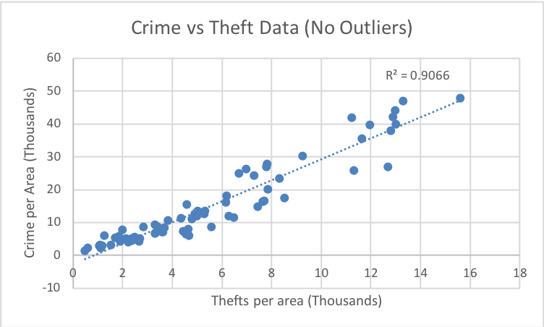
Crime vs Theft Data (No Outliers)

